Slide 1
Institutional Trajectories of the Welfare State: Returns from Social Policy Inception to Modern Public Opinion
Nate Breznau, breznau.nate@gmail.com
MPSA, 5.4.2024, 3pm, “Deservingness and the Welfare State”

Slide 2
Welfare State Institutions
Shape risk & welfare
Shape public opinion
Deeply embedded over time

Slide 3
Institutional Theories
Path dependencies
Positive returns
Stability over med/long term

Slide 4
Studying Institutions Public Opinion
No comparative / historical opinion data
Institutional trajectories not linear

Slide 5
A Theory of Positive Returns (Breznau 2017)
Public Opinion
(support of welfare state)
Welfare State Generosity
(generally speaking)
Time
The Golden Age
*Increasing returns
*Acceleration
The Silver Age
*Early Neo-liberalism
*Demographic change
*Stagnation
The Bronze Age
*Neo-liberalism
*Public loss of confidence
*Deceleration

Slide 6
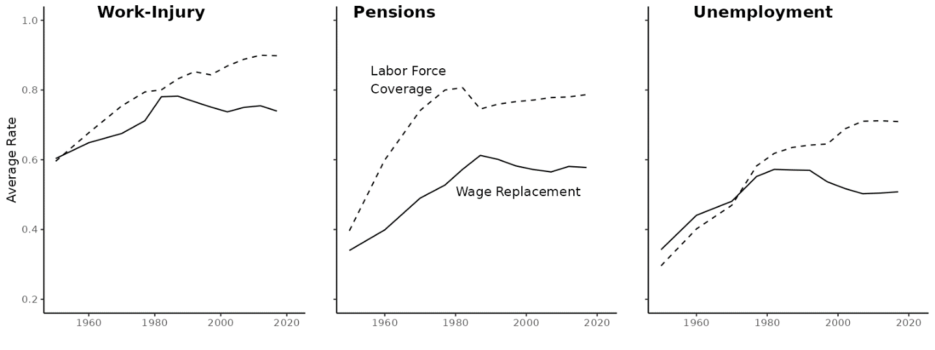
Note: Social Insurance Entitlements Dataset (Nelson et al. 2020), couple/family rate average for all countries with data also present in the ISSP (AUS, AUT, BEL, CAN, DNK, FIN, FRA, DEU, IRL, ITA, JPN, NLD, NZL, NOR, SWE, CHE, GBR, USA, CZE)

Slide 7
Test Case: ISSP & WeSIS
International Social Survey Program
‘Social Inequality’, support for redistribution
‘Role of Government’, support for welfare state scale (Breznau 2019)
46 Countries, slight coverage middle/low income
Welfare State Information System (August 2024!)
Interactive data portal
Stable DOI
186 countries, extensive social policy data since 1880

Slide 8
Measuring ‘Institutions’
Combined age
Work-injury + pensions + unemployment
Proxy for stage (golden / silver / bronze)
Since 1st law in each domain

Slide 9
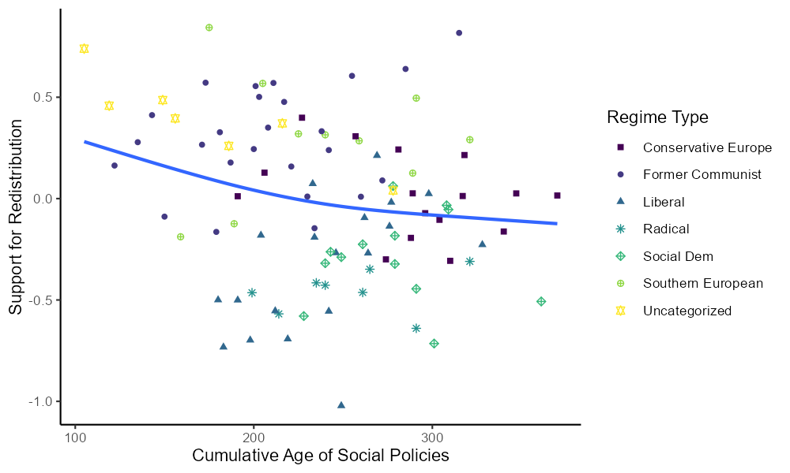
AUT, BEL, DEU, FRA & POL
RUS, BGR, HRV, HUN, LVA, SVK, SVN & CZE
USA, GBR, IRL, JPN, CHE & CAN
AUS, NZL
NLD, DNK, SWE, NOR & FIN
CYP, ITA, ESP & PRT
PHL, THA, ZAF, ISR & CHL

Slide 10
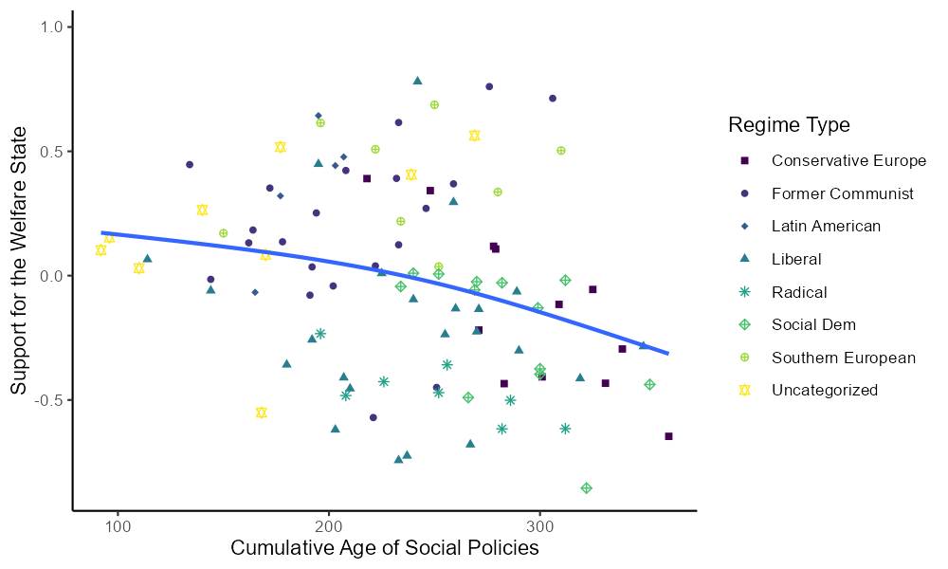
AUT, BEL, DEU, FRA & POL
RUS, BGR, HRV, HUN, LVA, SVK, SVN, CZE & LTU
DOM, CHL, URY & VEN
USA, GBR, IRL, JPN, CHE, CAN, TWN & KOR
AUS & NZL
NLD, DNK, SWE, NOR, FIN & ISL
CYP, ITA, ESP & PRT
PHL, THA, ZAF, ISR, IND, SUR & TUR

Slide 11
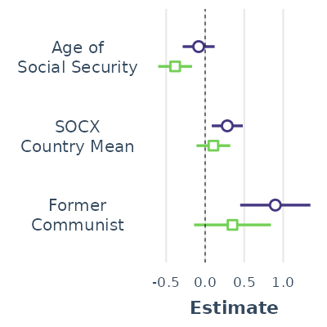
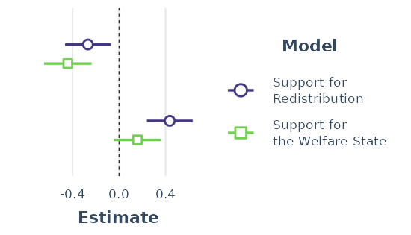
Regression Estimates
NOTE: OLS Regression. Coefficients XY-standardized for ease of interpretation.

Slide 12
Conclusions
Duration to measure institutional effects
External validity (massive time lag)
Humility – this is weak evidence

Slide 13
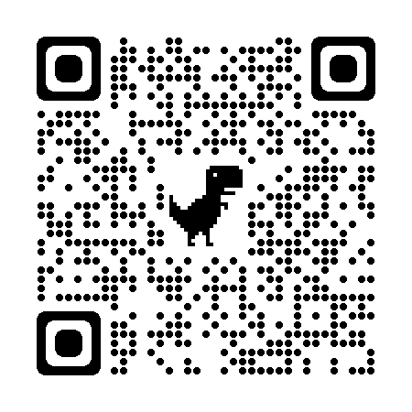
Thanks for your attention Breznau, Nate. 2023. “Institutional Trajectories of the Welfare State: Returns from Social Policy Inception to Modern Public Opinion.” Pp. 185–206 in A Research Agenda for Public Attitudes to Welfare, edited by F. Roosma and T. Laenen. Cheltenham, UK: Edward Elgar.
Replication materials

Slide 14
References
Breznau, Nate. 2017. “Positive Returns and Equilibrium: Simultaneous Feedback Between Public Opinion and Social Policy.” Policy Studies Journal 45(4):583–612. doi: 10.1111/psj.12171.
Breznau, Nate. 2019. “The Underlying Public Attitude toward Government Responsibility to Intervene in Socio-Economics, Thirty-Years of Evidence from the ISSP.” International Journal of Sociology 49(3):182–203. doi: https://doi.org/10.1080/00207659.2019.1605028.
Nelson, Kenneth, Daniel Fredriksson, Tomas Korpi, Walter Korpi, Joakim Palme, and Ola Sjöberg. 2020. “The Social Policy Indicators (SPIN) Database.” International Journal of Social Welfare 29(3):285–89. doi: 10.1111/ijsw.12418.

